Slide 1
CLASS DESIGN. INHERITANCE, POLYMORPHISM

Slide 2
AGENDA
C# OOP Concepts
Types of Inheritance
Implementation of Inheritance
Abstract class
Virtual Methods
Abstract Methods
Methods Overriding
Virtual properties
Properties overriding
Sealed class
Sealed methods and Properties

Slide 3
C# OOP CONCEPTS
Object
is any entity that has state and behavior.
Object can be physical and logical.
Class
is user defined prototype from which objects are created.
Class represents the set of properties and methods that are common to all objects of one type. It is a logical entity.

Slide 4
C# OOP CONCEPTS
Inheritance
is the mechanism when one class acquires all the properties and behaviors of parent class.
It provides code reusability.
Encapsulation
is mechanism of binding (or wrapping) code and data together into a single unit and protect them from external places.
A class is the example of encapsulation.
Polymorphism
is the ability of an object to take on many forms.
It allows us to perform a single action in different ways.

Slide 5
TYPES OF INHERITANCE
Implementation of inheritance
means that a type derives from a base type, taking all the base type’s member fields and functions.
Class inheritance
means that a derived class inherits all fields and methods of parent class along with their implementation.
Interface inheritance
means that derived type inherits only the signatures of the methods and does not inherit any implementations.

Slide 6
IMPLEMENTATION OF INHERITANCE
Inheritance enables us to create new classes that reuse, extend, and modify the behavior that is defined in other classes.
The class whose members are inherited is called the base class, and the class that inherits those members is called the derived class.
The idea of inheritance implements the IS-A relationship.

Slide 7






IMPLEMENTATION OF INHERITANCE
Animal
Cat
Transport
Car
Shape
Rectangle

Slide 8
IMPLEMENTATION OF INHERITANCE
A derived class can have only one direct base class.
Inheritance is transitive. If Class C is derived from Class B and Class B is derived from Class A, than Class C inherits the members declared in Class B and Class A.
Person
Mentor
Car
Staff
Student
Person
Transport
Invention
Developer
Mentor
Developer

Slide 9
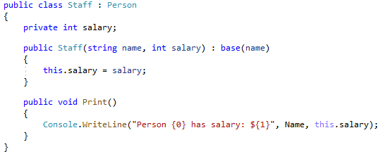
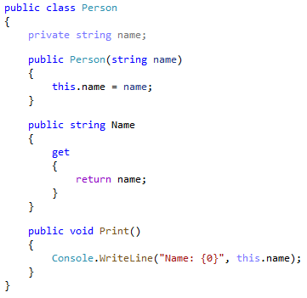

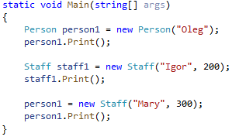

IMPLEMENTATION OF INHERITANCE

Slide 10
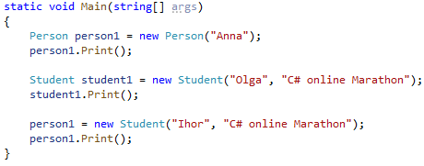
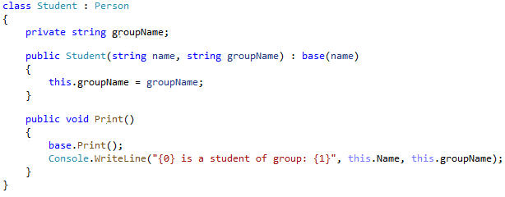

IMPLEMENTATION OF INHERITANCE
The base keyword is used to access members of the base class from a derived class

Slide 11
ABSTRACT CLASS

Slide 12

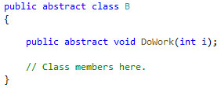
ABSTRACT CLASS
An abstract class cannot be instantiated.
The purpose of an abstract class is to provide a common definition of a base class that multiple derived classes can share.
Abstract classes may define abstract methods.
Derived classes of the abstract class must implement all abstract methods.

Slide 13
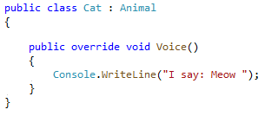
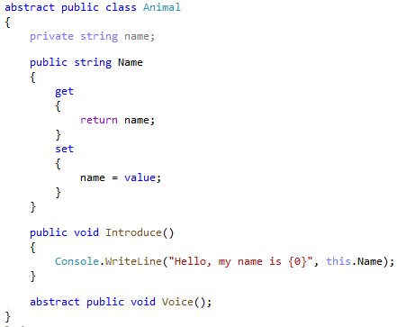
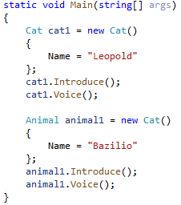

ABSTRACT CLASS

Slide 14
VIRTUAL, OVERRIDING

Slide 15
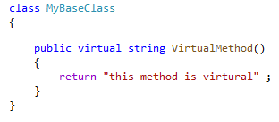

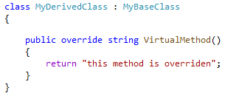
VIRTUAL METHODS. ABSTRACT METHODS. METHODS OVERRIDING
Virtual method is method that can be overridden in any derived class.
Abstract method is method that that doesn’t have it’s implementation in the base class and must be overridden in any non-abstract derived class.
Abstract method declaration are only permitted in abstract classes.
Method overriding is changing the implementation of a method that is provided by parent class.

Slide 16
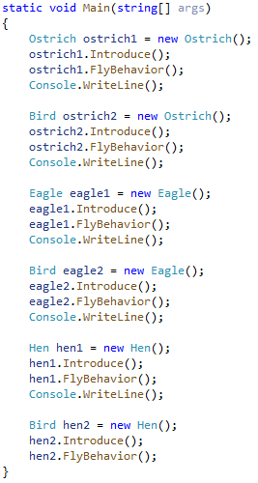
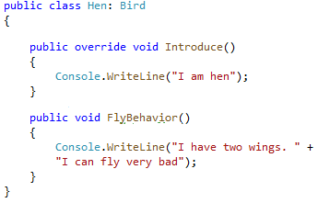
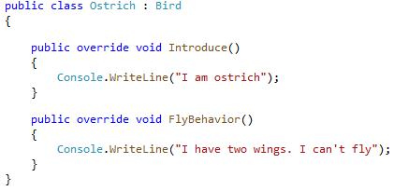
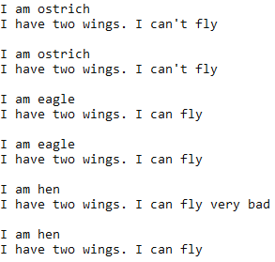
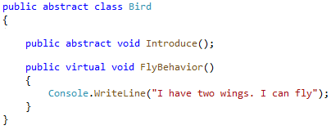
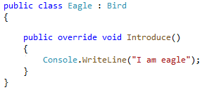
VIRTUAL METHODS. ABSTRACT METHODS. METHODS OVERRIDING

Slide 17
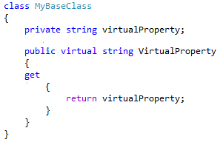
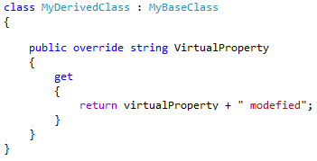
VIRTUAL PROPERTIES. PROPERTIES OVERRIDING
Virtual property is a property that can be overridden in any derived class.

Slide 18
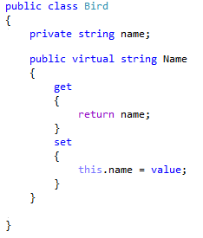
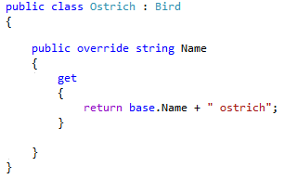
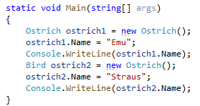

VIRTUAL PROPERTIES. PROPERTIES OVERRIDING

Slide 19
SEALED

Slide 20


SEALED CLASS
Sealed modifier
is modifier that can be applied to class to prevent other classes from inheriting from him.

Slide 21
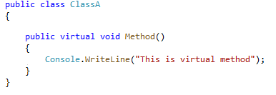
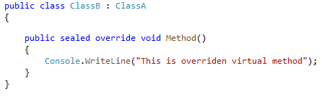
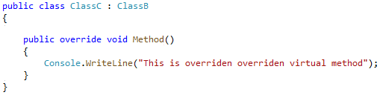
SEALED METHODS AND PROPERTIES
Sealed modifier
can also be applied to methods or properties that overrides methods or properties declared in base class to prevent them from overriding in derived classes.

Slide 22
THANK YOU!

Slide 23


